Slide 1
CIS*3760 - Group 104
Sprint 8 Retrospective
Team members:
Michaela Hibbert Harir Al-Rubaye
Dipto Biswas Pradhapan Rajendran
Justin Klein Emma Shortt
Sky Truong Faraan Usman

Slide 2
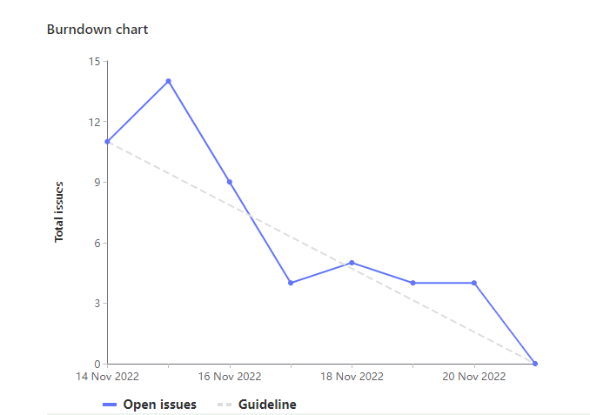
Burndown Chart (GitLab):

Slide 3

What went well:
Great attendance for meetings, held valuable discussions on what tasks should be prioritized
Good collaboration, broke off into pairs to efficiently complete issues, often ahead of time
Added more tests for higher fault tolerance, deployments were smoother

Slide 4

What can be improved:
Maintaining tests better, always updating tests with new code changes

Slide 5
Course Work for Sprint 8: Prad
Total hours: 10 hours (20 weights)
Team Lead Duties (monitoring and updating board, creating issues)
Created and maintained update log to actively plan ahead for future improvements
Updated user guide and docs

Slide 6
Course Work for Sprint 8: Faraan
Total hours: 10 (20 Weights)
Implemented schedule printing functionality
Pair programmed to create backend/frontend functionality to export to .ics file
Attended sprint meetings

Slide 7
Course Work for Sprint 8: Dipto
Total hours: 10 hours (20 weights)
Pair programmed to create backend/frontend functionality to export to .ics file
Research how to create ICS (calendar file format) file
Attended sprint meetings

Slide 8
Course Work for Sprint 8: Emma
Total hours: 11 hours (22 Weights)
Researched, configured, and implemented front-end testing using jest
Updated getCourseTitles api to be a post request and use 2 different semesters
Attended all meetings

Slide 9
Course Work for Sprint 8: Justin
Total hours: 10 hours (20 weights)
Created UI for choosing F22 or W23 Semester
Refactored selected & suggested courses to clear when semesters change
Implemented new ‘Delete Course’ functionality
Added favicon.io to the site
Attended all meetings

Slide 10
Course Work for Sprint 8: Sky
Total hours: 10 hrs (20 Weights)
Refactored backend to send fall vs winter data
Updated json schema and mock data in test file
Document Sprint9 ideas
Attended all sprint meetings

Slide 11
Course Work for Sprint 8: Michaela
Total hours: 10 hours (20 weights)
Implemented Local Storage in the React App
Implemented the delete functionality to clear schedule
Updated the Schedule Tooltip to a more custom design
Attended all sprint meetings

Slide 12
Course Work for Sprint 8: Harir
Total hours: 10 hours (20 Weights)
Research React Router
Setup a react routing for a new page, created new page and added demo data.
Attended all meetings

Slide 13
Demo Overview
Support for Winter 2023 courses
Cookies to store user selections
Delete and clear course buttons
Allow user to print schedule

